Slide 1

ATTACK VECTORS

Slide 2

Attack vector is also called as threat vector.
An attack vector or threat vector is a way for attackers to enter a network or system.
Common attack vectors include social engineering attacks, credential theft, vulnerability exploits,.

Slide 3
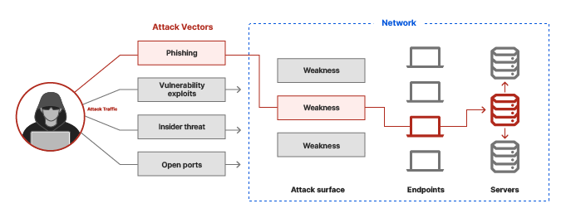

Slide 4
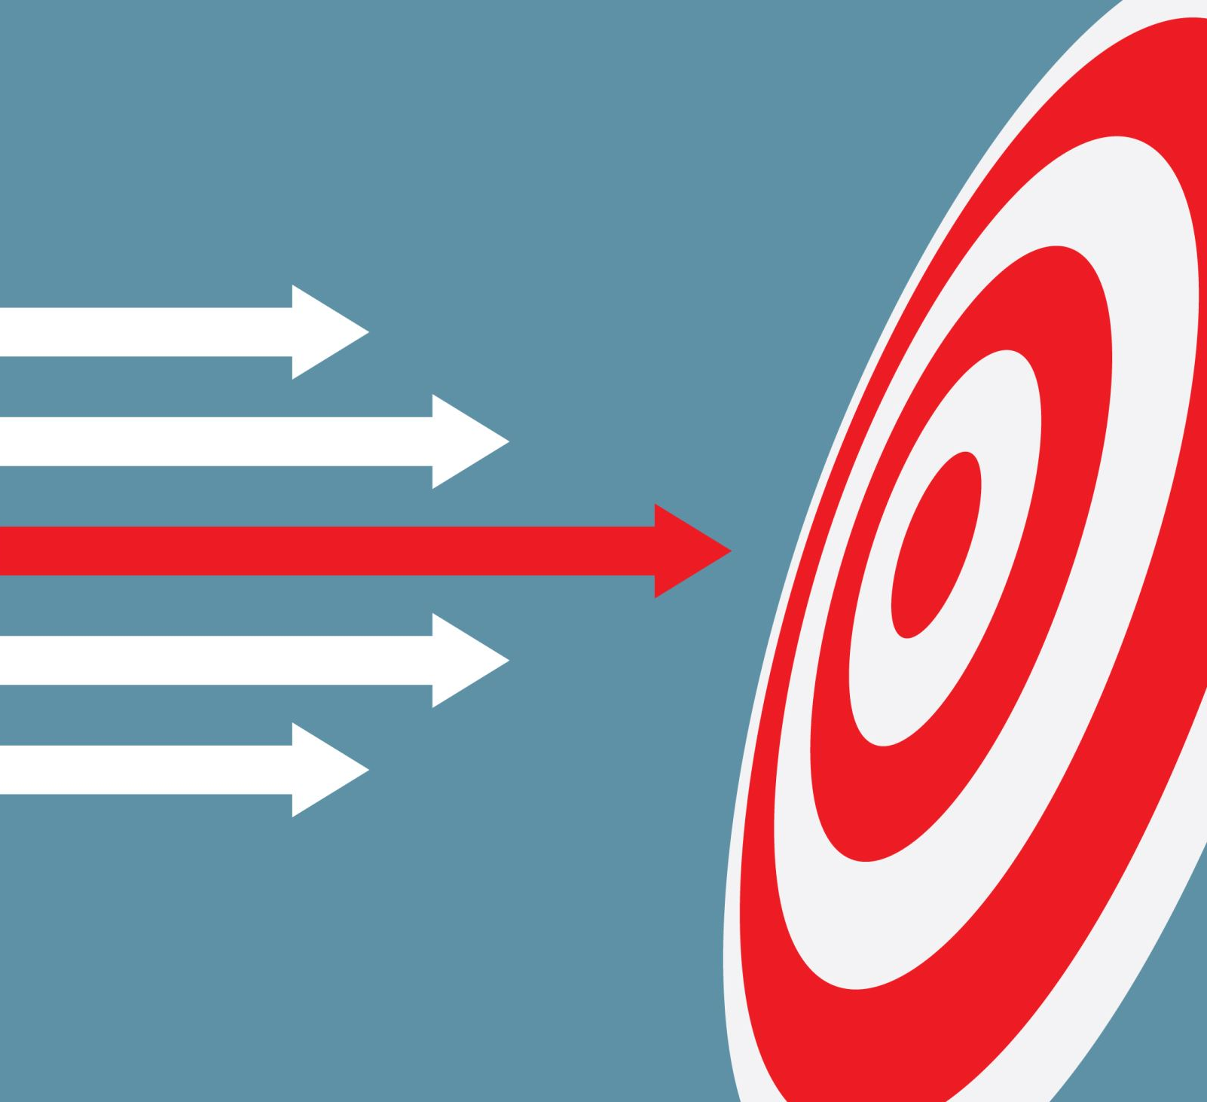

Types of attack vectors
Direct attack vectors-These attack vectors are those which affect the target directly such as malware, phishing.
Indirect attack vectors-These attack vectors are those where the attacker indirectly exploits vulnerabilities in other systems via an internet browser.

Slide 5
Some of the most common attack vectors
Phishing
Email attachments
Account takeover
Lack of encryption
Insider threats
Open ports
Application compromise

Slide 6

Approaches to stop attacks
Encryption
Secure access service edge(SASE)
Patching vulnerablilities

